Slide 1
BAN 612: Data Analytics
Dr. Jia Guo
California State University, East Bay
College of Business and Economics
NumPy

Slide 2
Installation
NumPy usually comes with Python that you installed.
If you installed Anaconda 3 but use python 2, please try the following to import NumPy:
import sys
!{sys.executable}-m pip install numpy
import numpy as np

Slide 3
NumPy
Fundamental package for high performance scientific computing and data analysis
It provides:
ndarray: vectorized arithmetic operations and broadcasting capabilities
Standard mathematical functions for fast operations on entire arrays of data. No need to write loops.
Tools for reading/writing array data
Linear algebra, random number generation and so on..

Slide 4
N-dimensional Array Object (or ndarray)
We need to import numpy when we use ndarray.
This is a fast, flexible container for large data set. This is also an object.
Similarly, regular array:
List is an Array.
A array can hold many values (in various data type) under a single name and you can access the value by referring to the index number.

Slide 5
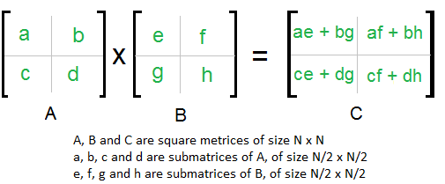
Multiplication of Two Matrices

Slide 6
Practice in Jupyter Notebook
See Lecture_NumPy.ipynb
Outline
NumPy Intro
NumPy Array
Numerical Operations on Matrices
Universal Functions
Conditional Logics
Mathematical and Statistical Methods
Random number generation
Example: Random Walks

Slide 7
Homework
Repeat Lecture_Numpy code and exercise.
Read Python for Data Analysis Chap 4 thoroughly.

